Slide 1
UNIT-3 PROCESS SYNCHRONIZATION – Palvi Soni

Slide 2
Before starting synchronization lets start with concurrent processing
Concurrent processing is a computing model in which multiple processors execute instructions simultaneously for better performance.
Concurrent means, which occurs when something else happens. The tasks are broken into subtypes, which are then assigned to different processors to perform simultaneously.
Concurrent processing is sometimes synonymous with parallel processing.

Slide 3
TYPES OF PROCESSES
On the basis of synchronization, processes are categorized as one of the following two types:
Independent Process: The execution of one process does not affect the execution of other processes.
Cooperative Process: A process that can affect or be affected by other processes executing in the system.

Slide 4
WHAT IS PROCESS SYNCRONIZATION?
Processes Synchronization or Synchronization is the way by which processes that share the same memory space are managed in an operating system. It helps maintain the consistency of data by using variables or hardware so that only one process can make changes to the shared memory at a time. There are various solutions for the same such as semaphores, mutex locks, synchronization hardware, etc.

Slide 5
How Process Synchronization in OS Works?
Let us take a look at why exactly we need Process Synchronization. For example, If a process1 is trying to read the data present in a memory location while another process2 is trying to change the data present at the same location, there is a high chance that the data read by the process1 will be incorrect.

Slide 6
DIFFERENT PROGRAM SECTIONS
Entry Section: The entry Section decides the entry of a process.
Critical Section: Critical section allows and makes sure that only one process is modifying the shared data.
Exit Section: The entry of other processes in the shared data after the execution of one process is handled by the Exit section.
Remainder Section: The remaining part of the code which is not categorized as above is contained in the Remainder section.

Slide 7
Race Condition
When more than one process is either running the same code or modifying the same memory or any shared data, there is a risk that the result or value of the shared data may be incorrect because all processes try to access and modify this shared resource. Thus, all the processes race to say that my result is correct. This condition is called the race condition. Since many processes use the same data, the results of the processes may depend on the order of their execution.
EXAMPLE – MONEY DEBITED WHILE ONLINE SHOPPING BUT ORDER NOT PLACED
But how to avoid this race condition? There is a simple solution:
by treating the critical section as a section that can be accessed by only a single process at a time. This kind of section is called an atomic section.

Slide 8
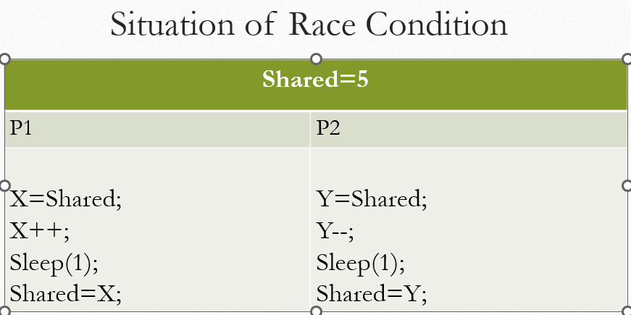
RACE CONDITION SITUATION

Slide 9
What is the Critical Section Problem?
A part of code that can only be accessed by a single process at any moment is known as a critical section. This means that when a lot of programs want to access and change a single shared data, only one process will be allowed to change at any given moment. The other processes have to wait until the data is free to be used.

Slide 10
Requirements of Synchronization
The following three requirements must be met by a solution to the critical section problem:
Mutual exclusion: If a process is running in the critical section, no other process should be allowed to run in that section at that time.
Progress: If no process is still in the critical section and other processes are waiting outside the critical section to execute, then any one of the threads must be permitted to enter the critical section. The decision of which process will enter the critical section will be taken by only those processes that are not executing in the remaining section.
Bounded/waiting (No starvation): Starvation means a process keeps waiting forever to access the critical section but never gets a chance. No starvation is also known as Bounded Waiting. Assigning a time bound, can help the process in this case.
Architectural neutrality:-Our mechanism must be architectural natural. It means that if our solution is working fine on one architecture then it should also run on the other ones as well.

Slide 11
Solutions To The Critical Section Problem
Peterson's solution
Peterson's approach to critical section problems is extensively utilized. It is a classical software-based solution.
The solution is based on the idea that when a process is executing in a critical section, then the other process executes the rest of the code and vice-versa is also possible, i.e., this solution makes sure that only one process executes the critical section at any point in time.

Slide 12
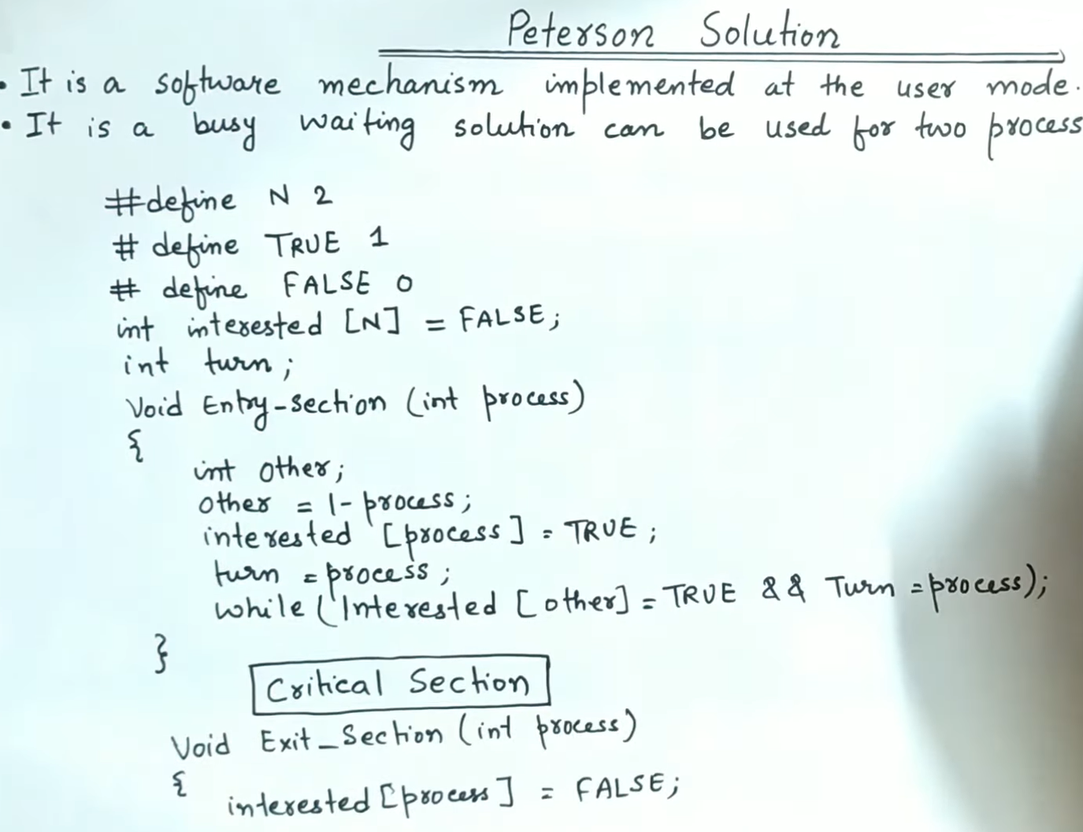

Slide 13
EXPLANATION OF PETERSON
Peterson’s Algorithm is used to synchronize two processes. It uses two variables, process and other and an int variable turn to accomplish it. In the solution interested for P0 represents the process0 and interested for P1 represents the Process P1.
Initially the interested variables are false. When a process wants to execute it’s critical section, it sets it’s interested[process] to true and turn as the index of the executing process.
. The process performs busy waiting until the other process has finished it’s own critical section. After this the current process enters it’s critical section and adds or removes a random number from the shared buffer. After completing the critical section, it sets it’s interested process to false, indication it does not wish to execute anymore.

Slide 14
DISADVANTAGES OF PETERSON
The Peterson's solution involves Busy waiting
The solution is also limited to only 2 processes.

Slide 15
LOCK VARIABLE
This is the simplest synchronization mechanism.
This is a Software Mechanism implemented in User mode.
This is a busy waiting solution which can be used for more than two processes.
Does not guarantee Mutual Exclusion

Slide 16
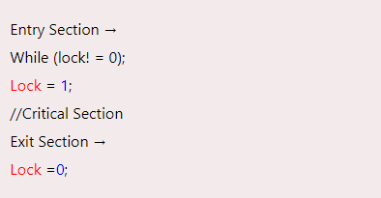
PSUEDOCODE OF LOCK VARIABLE

Slide 17
CHECK FOR THE POSSIBLE CASES
Initially lock value is set to zero(0).
Process P1 is running the entry code
Check out first instruction 0!==0 (false), get out of loop then set the value of lock to 1
After that it can enters in the CS. Upon successful completion in CS, it will run exit section code, then set the value of lock to 0 again. Now if P2 wants to come, it can. This could be the best possible case.

Slide 18
ANOTHER CASE
If P1 is in critical section and P2 wants to come. Already P1 has set the lock value to 1 in instruction number 2, so if P2 will be going to check the value then it will get stuck in the while loop, so mutual exclusion is there. That means process(which is already in the CS i.e P1) is not allowing any other process to enter in the critical section

Slide 19
WORST CASE
What if the process gets preempted just after executing the first instruction. This may make the two processes present in the critical section at the same time.
To get rid of this problem, we have to make sure that the preemption must not take place just after loading the previous value of lock variable and before setting it to 1. The problem can be solved if we can be able to merge the first two instructions.
In order to address the problem, the operating system provides a special instruction called Test Set Lock.

Slide 20
Hardware Primitives of Synchronization
There is no guarantee that the Software-based solution like Peterson’s will work on modern architecture. Hence, certain hardware-based solution to synchronization are proposed. Two such solutions are: 1. TestAndSet() instruction 2. Swap() instruction

Slide 21
Test and Set Lock
Test and Set Lock (TSL) is a synchronization mechanism.
It uses a test and set instruction to provide the synchronization among the processes executing concurrently.
Executes as a single atomic operation.
If one process is currently executing a test-and-set, no other process is allowed to begin another test-and-set until the first process test-and-set is finished.

Slide 22
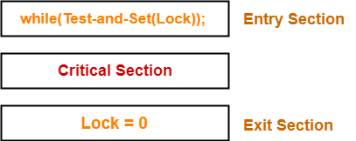
Lock value = 0 means the critical section is currently vacant and no process is present inside it. Lock value = 1 means the critical section is currently occupied and a process is present inside it.

Slide 23
TESTANDSET CASE 1
Process P₀ arrives.
It executes the test-and-set(Lock) instruction.
Since lock value is set to 0, so it returns value 0 to the while loop and sets the lock value to 1.
The returned value 0 breaks the while loop condition.
Process P₀ enters the critical section and executes.
Now, even if process P₀ gets preempted in the middle, no other process can enter the critical section.
Any other process can enter only after process P₀ completes and sets the lock value to 0.

Slide 24
TESTANDSET CASE 2
Another process P₁ arrives.
It executes the test-and-set(Lock) instruction.
Since lock value is now 1, so it returns value 1 to the while loop and sets the lock value to 1.
The returned value 1 does not break the while loop condition.
The process P₁ is trapped inside an infinite while loop.
The while loop keeps the process P₁ busy until the lock value becomes 0 and its condition breaks.

Slide 25
BEST CASE- TSL
Process P₀ comes out of the critical section and sets the lock value to 0.
The while loop condition breaks.
Now, process P₁ waiting for the critical section enters the critical section

Slide 26
TSL-CONDITIONS
It ensures mutual exclusion.
Ensures Progress
It does not guarantee bounded waiting and may cause starvation.

Slide 27
SWAP
When a process is inside the critical section than all other incoming process trying to enter the critical section is not maintained in any order or queue.
Any process out of all the waiting process can get the chance to enter the critical section as the lock becomes false.
So, there may be a process that may wait indefinitely.
So, bounded waiting is not ensured in Swap algorithm also.

Slide 28
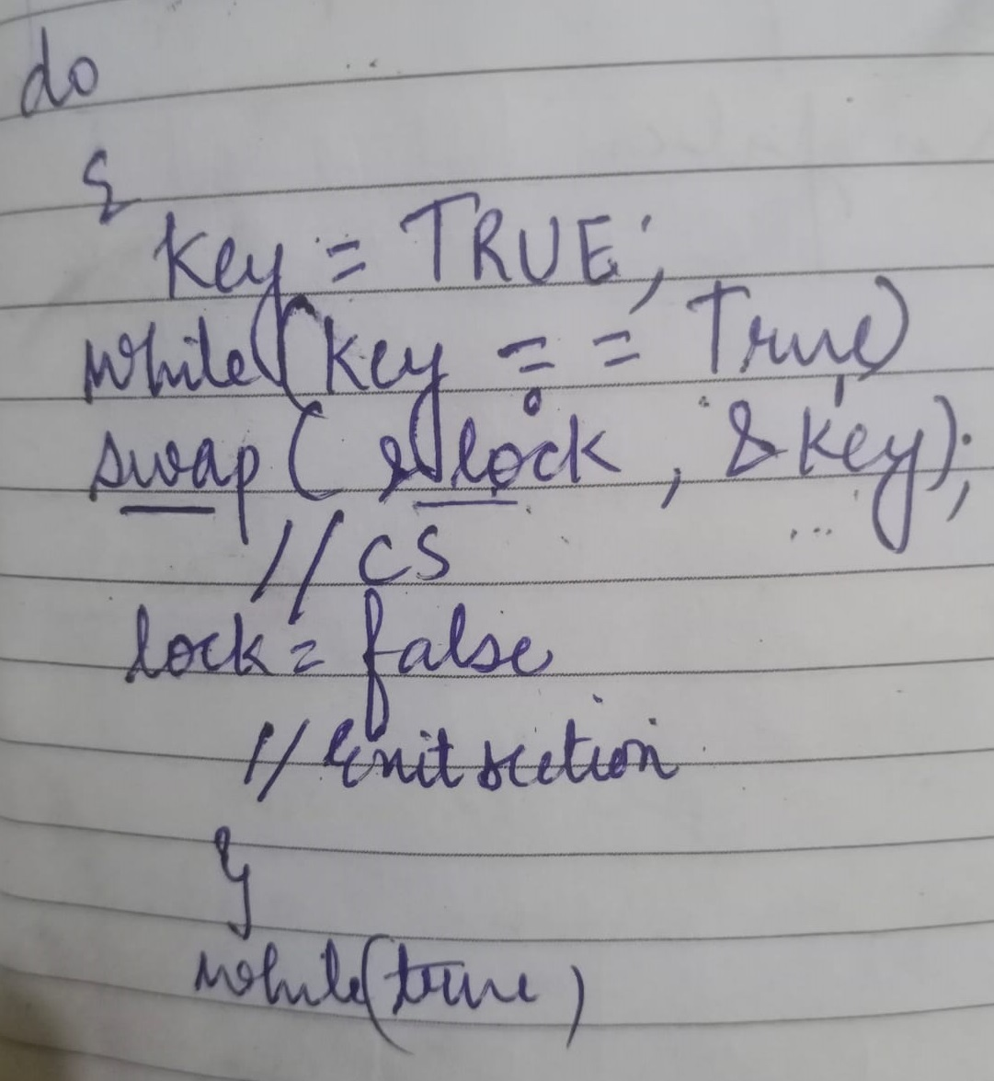
IMPLEMENTATION OF SWAP

Slide 29
CASES- LOCK VALUE =0, KEY VALUE=1
Initially lock value should set to false(0), and key value to true(1).
Implement the cases in the similar way.
For the first case, check for process P1, key=true, then key==true, then swap(&lock, &key), so swapped values become 1 and 0 respectively.
Now P1 is in the cs, after executing swap instruction. After CS execution, it will again set lock=0(false), so now P1 can enter. So Progress is achieved. This is the best possible case.

Slide 30
CASE 2
P1 is in the CS, then at same time P2 comes, lock value is swapped already that means it has been changed from 0 to 1, so if P2 will perform swap operation, it will get stuck in the swap statement, as P1 is already there. So Mutual exclusion is there as one process is already there and it is restricting the other process to enter in the CS.

Slide 31
Classical Problems of Process Synchronization
Producer Consumer Problem/Bounded Buffer problem
Reader-Writer Problem
Dining Philosopher Problem

Slide 32
PRODUCER CONSUMER PROBLEM
Buffer Can be:
1. Unbounded Buffer:
No buffer size limit
Any no. of items can be stored
Producer can produce on any rate, there will always be space in buffer
2. Bounded Buffer:
Limited buffer size

Slide 33
PRODUCER CONSUMER PROBLEM CONTD.
Bounded Buffer:
If rate of Production > rate of Consumption:
Some items will be unconsumed in buffer
If rate of Production < rate of Consumption:
At some time buffer will be empty

Slide 34
PRODUCER CONSUMER PROBLEM CONTD.
"in" used in a producer code represent the next empty buffer
"out" used in consumer code represent first filled buffer
count keeps the count number of elements in the buffer
Initial value of count, in and out is zero

Slide 35
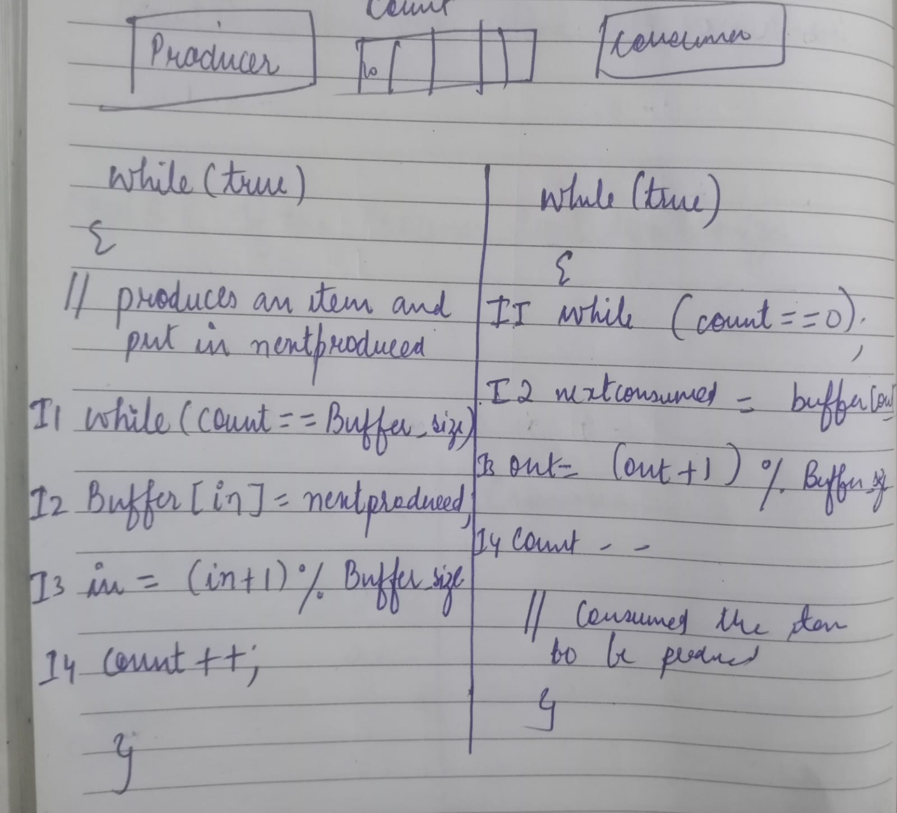
PRODUCER CONSUMER CONTD.

Slide 36
CASES- DISCUSSED IN CLASSROOM
Assuming the buffer size as 5.
Start checking the code of producer , then store the items in the producer buffer[in]
Also increase the count as you are going to add the items.
When the buffer is full, you have to check for the case of consumer, consumer will consume the items that is stored in the buffer by producer.

Slide 37
READER WRITER PROBLEM
The readers-writers problem relates to an object such as a file that is shared between multiple processes. Some of these processes are readers i.e. they only want to read the data from the object and some of the processes are writers i.e. they want to write into the object.
The readers-writers problem is used to manage synchronization so that there are no problems with the object data. For example - If two readers access the object at the same time there is no problem. However if two writers or a reader and writer access the object at the same time, there may be problems.
To solve this situation, a writer should get exclusive access to an object i.e. when a writer is accessing the object, no reader or writer may access it. However, multiple readers can access the object at the same time.

Slide 38
READER WRITER PROBLEM
If one of the person tries editing the file, no other person should be reading or writing at the same time, otherwise changes will not be visible to him/her.
However if some person is reading the file, then others may read it at the same time.
Precisely in OS we call this situation as the readers-writers problem
Problem parameters:
One set of data is shared among a number of processes
Once a writer is ready, it performs its write. Only one writer may write at a time
If a process is writing, no other process can read it
If at least one reader is reading, no other process can write
Readers may not write and only read

Slide 39
READER WRITER PROBLEM
Case | Process 1 | Process 2 | Allowed/Not Allowed
Case 1 | Writing | Writing | Not Allowed
Case 2 | Writing | Reading | Not Allowed
Case 3 | Reading | Writing | Not Allowed
Case 4 | Reading | Reading | Allowed

Slide 40
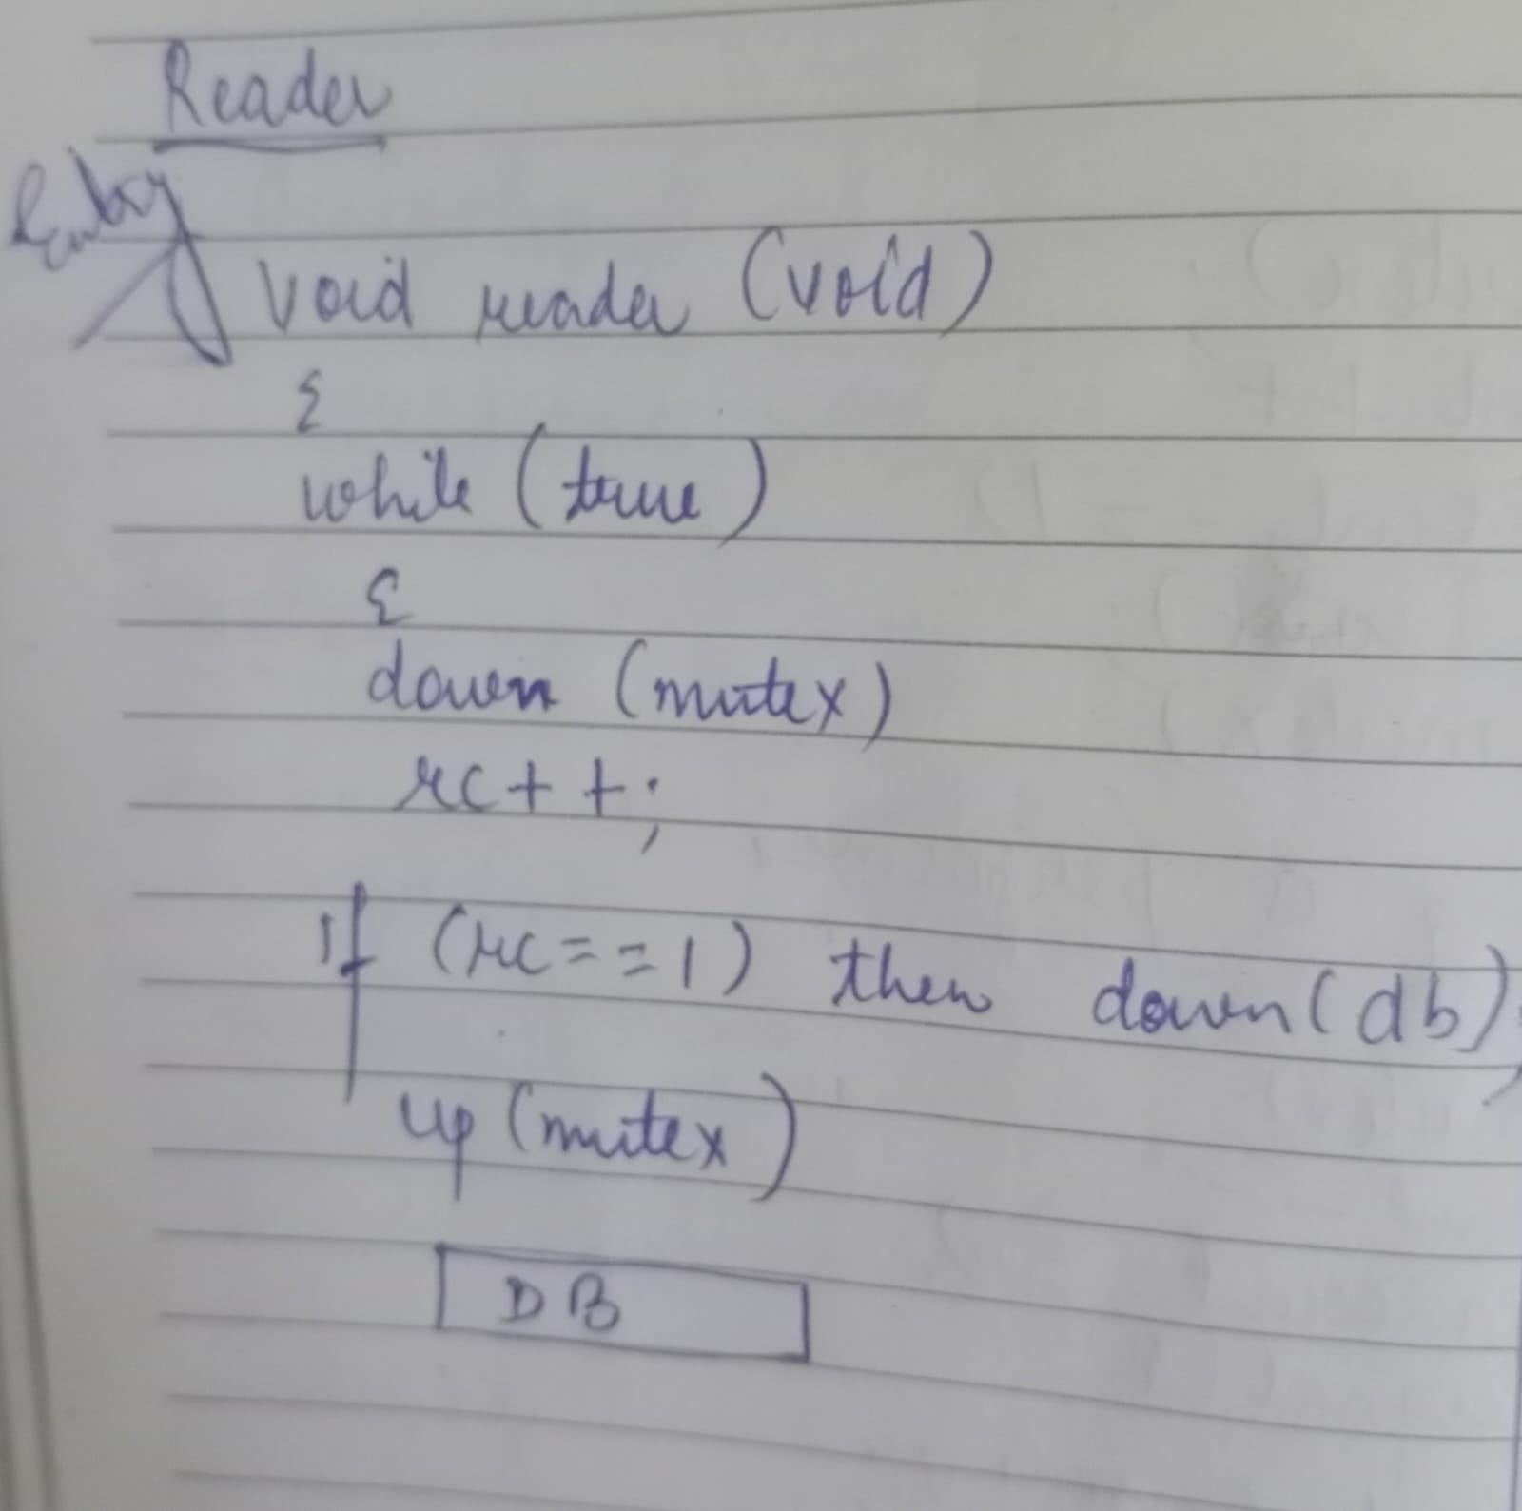
ENTRY CODE OF READER-INITIALLY RC=0,MUTEX=1 AND DB=1

Slide 41
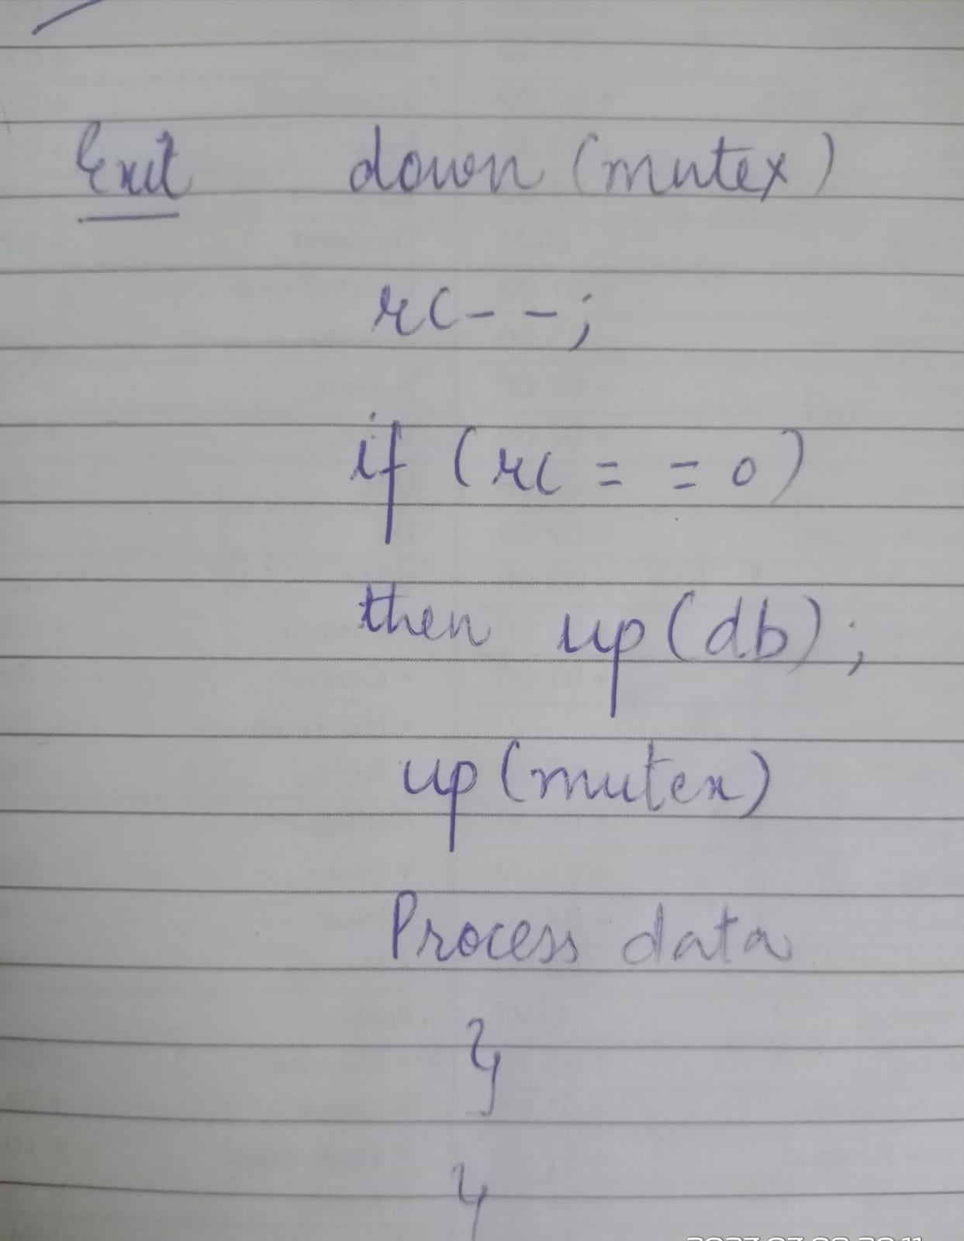
EXIT CODE OF READER

Slide 42
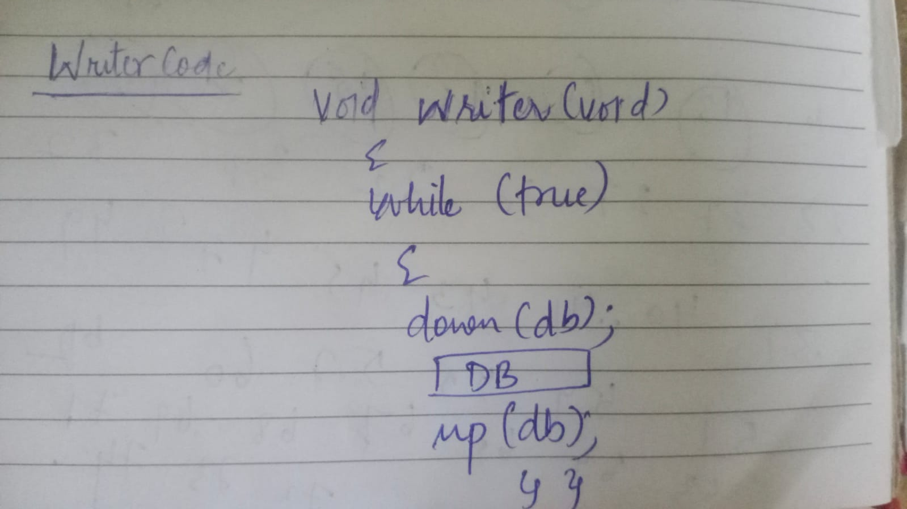
WRITER PSEUDOCODE

Slide 43
DINING PHILOSPHER PROBLEM
The dining philosopher's problem is the classical problem of synchronization which says that Five philosophers are sitting around a circular table and their job is to think and eat alternatively. A bowl of noodles is placed at the center of the table along with five chopsticks for each of the philosophers. To eat a philosopher needs both their right and a left chopstick. A philosopher can only eat if both immediate left and right chopsticks of the philosopher is available. In case if both immediate left and right chopsticks of the philosopher are not available then the philosopher puts down their (either left or right) chopstick and starts thinking again.

Slide 44
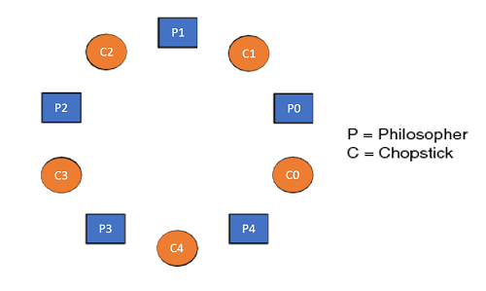
DINING PHILOSPHER PROBLEM

Slide 45
Void Philosopher
{
while(1)
{
take_chopstick[i];
take_chopstick[ (i+1) % 5] ;
. .
. EATING THE NOODLE
.
put_chopstick[i] );
put_chopstick[ (i+1) % 5] ;
.
. THINKING
}
}

Slide 46
DINING PHILOSPHER PROBLEM
Suppose Philosopher P0 wants to eat, it will enter in Philosopher() function, and execute take_chopstick[i]; by doing this it holds C0 chopstick after that it execute take_chopstick[ (i+1) % 5]; by doing this it holds C1 chopstick( since i =0, therefore (0 + 1) % 5 = 1)
Similarly suppose now Philosopher P1 wants to eat, it will enter in Philosopher() function, and execute take_chopstick[i]; by doing this it holds C1 chopstick after that it execute take_chopstick[ (i+1) % 5]; by doing this it holds C2 chopstick( since i =1, therefore (1 + 1) % 5 = 2)
But Practically Chopstick C1 is not available as it has already been taken by philosopher P0, hence the above code generates problems and produces race condition.

Slide 47
The solution of the Dining Philosophers Problem
We use a semaphore to represent a chopstick and this truly acts as a solution of the Dining Philosophers Problem. Wait and Signal operations will be used for the solution of the Dining Philosophers Problem, for picking a chopstick wait operation can be executed while for releasing a chopstick signal semaphore can be executed.
Semaphore: A semaphore is an integer variable in S, that apart from initialization is accessed by only two standard atomic operations - wait and signal, whose definitions are as follows:

Slide 48
SOLUTION WITH SEMAPHORE-DINING PHILOSPHER
void Philosopher
{
while(1)
{
Wait( take_chopstickC[i] );
Wait( take_chopstickC[(i+1) % 5] ) ;
. .
. EATING THE NOODLE
.
Signal( put_chopstickC[i] );
Signal( put_chopstickC[ (i+1) % 5] ) ;
.
. THINKING
}
}

Slide 49
SOLUTION WITH SEMAPHORE-DINING PHILOSPHER
In the above code, first wait operation is performed on take_chopstickC[i] and take_chopstickC [ (i+1) % 5]. This shows philosopher i have picked up the chopsticks from its left and right. The eating function is performed after that.
On completion of eating by philosopher i the, signal operation is performed on take_chopstickC[i] and take_chopstickC [ (i+1) % 5]. This shows that the philosopher i have eaten and put down both the left and right chopsticks. Finally, the philosopher starts thinking again.

Slide 50
DINING PHILOSPHER PROBLEM
Possible solutions to the deadlock problem
Allow at most four philosophers to be sitting simultaneously at the table.
Allow a philosopher to pick up her chopsticks only if both chopsticks are available (note that she must pick them up in a critical section).
Use an asymmetric solution; that is,
odd philosopher: left first, and then right
an even philosopher: right first, and then left
Besides deadlock, any satisfactory solution to the DPP problem must avoid the problem of starvation.

Slide 51
SEMAPHORE
Semaphores are integer variables that are used to solve the critical section problem.
After Initialization, it can be accessed by two atomic operations.
Operations On Semaphore:
wait() and signal()
Entry to C.S. is controlled by wait()
Exit from C.S. is signaled by signal()

Slide 52
SEMAPHORE CONTD.
The wait operation decrements the value of the semaphore
The signal operation increments the value of the semaphore.
When the value of the semaphore is zero, any process that performs a wait operation will be blocked until another process performs a signal operation.
Initial Value of Semaphore is 1.

Slide 53
SEMAPHORE CONTD.
Wait operation is also called P, sleep, or down operation,
Signal operation is also called V, wake-up, or up operation.
Both operations are atomic and semaphore(s) is always initialized to one.
Here atomic means that variable on which read, modify and update happens at the same time/moment with no pre-emption i.e. in-between read, modify and update no other operation is performed that may change the variable.
A critical section is surrounded by both operations to implement process synchronization. S

Slide 54
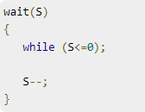

Semaphore Operations- ENTRY AND EXIT OPERATION

Slide 55
DISADVANTAGE OF SEMAPHORE-Semaphore and Busy waiting
Disadvantage of Semaphore: Busy Waiting
When a process is in C.S. and any other process that wants to enter C.S. loops continuously in entry section.
Wastes CPU cycles
Semaphore that implements busy waiting is known as: Spin Lock

Slide 56
Semaphore with No Busy waiting
With each semaphore there is an associated waiting queue. Each entry in a waiting queue has two data items:
value (of type integer)
pointer to next record in the list
Instead of waiting, a process blocks itself.
Two operations:
block – place the process invoking the operation on the waiting queue.
wakeup – remove one of processes in the waiting queue and place it in the ready queue.

Slide 57
TYPES OF SEMAPHORE
Binary Semaphore – This is also known as mutex lock.
It can have only two values – 0 and 1.
Its value is initialized to 1.
It is used to implement the solution of critical section problems with multiple processes.
Counting Semaphore – Its value can range over an unrestricted domain.
It can have values from -∞ to ∞.

Slide 58
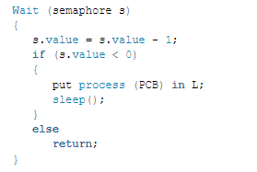
COUNTING SEMAPHORE-ENTRY SECTION PSEUDOCODE

Slide 59
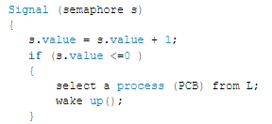
COUNTING SEMAPHORE-ENTRY SECTION PSEUDOCODE

Slide 60
MONITORS
A way to encapsulate the Critical Section by making class around the critical section and allowing only one process to be active in that class at one time.
Only one process may be active within the monitor at a time
Name of Monitor
Initialization Code Section
Procedure to request the Critical Data
Procedure to release the Critical Data

Slide 61
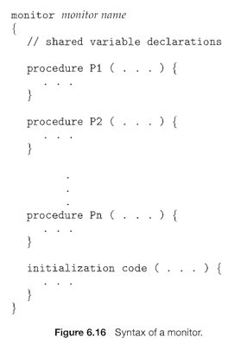
MONITORS

Slide 62
MONITORS
The monitor construct is not sufficiently powerful for modeling some synchronization schemes.
So, we need to define additional synchronization mechanisms.
These mechanisms are provided by the condition construct.
A programmer can define one or more variables of type condition:
condition x, y;
The only operations that can be invoked on a condition variable are wait () and signal().

Slide 63
MONITORS OPERATIONS
Two operations on a condition variable:
x.wait () – a process that invokes the operation is suspended until another
process invokes x.signal()
x.signal () – resumes one of processes (if any) that invoked x.wait ()

Slide 64
PROCESS HIERACHY
A process can create several new processes during its time of execution.
The creating process is called the Parent Process and the new process is called Child Process.
Execution − The child process is executed by the parent process concurrently or it waits till all children get terminated.
Sharing − The parent or child process shares all resources like memory or files or children process shares a subset of parent’s resources or parent and children process share no resource in common.

Slide 65
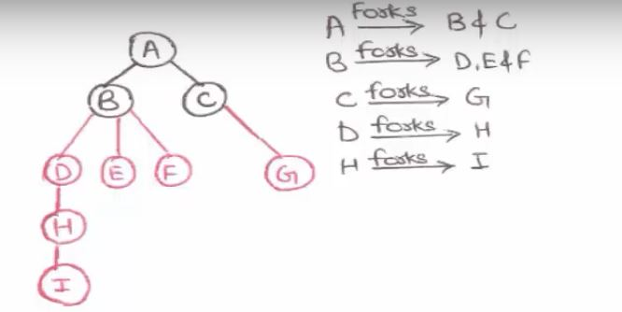
PROCESS HIERARCHY

Slide 66
The reasons that parent process terminates the execution of one of its children are as follows −
The child process has exceeded its usage of resources that have been allocated. Because of this there should be some mechanism which allows the parent process to inspect the state of its children process.
The task that is assigned to the child process is no longer required.

Slide 67
Precedence of Graph
Precedence Graph is a directed acyclic graph which is used to show the execution level of several processes in operating system.
It consists of nodes and edges.
Nodes represent the processes and the edges represent the flow of execution.
A directed edge from node A to node B shows that statement A executes first and then Statement B executes.

Slide 68
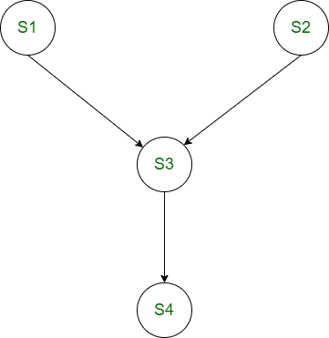
S1 : a = x + y; S2 : b = z + 1; S3 : c = a - b; S4 : w = c + 1;

Slide 69
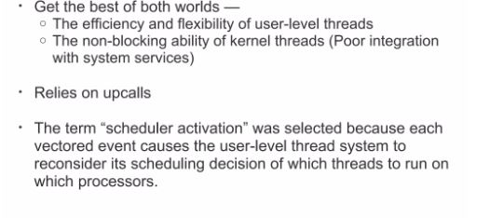
SCHEDULER ACTIVATION
A mechanism that facilitates exchange of information between user-level and kernel-level mechanisms

Slide 70
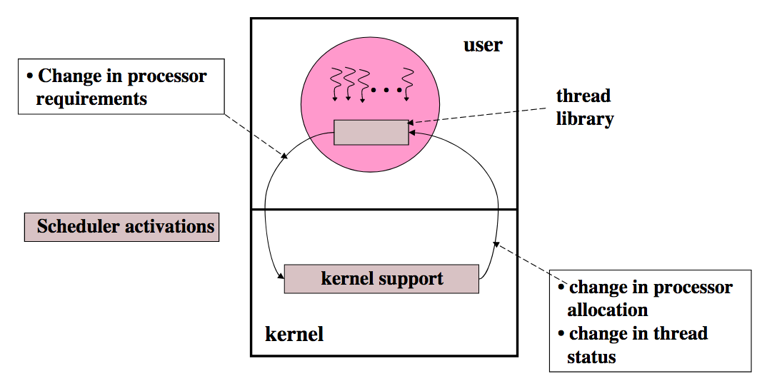
STRUCTURE OF SA

Slide 71
When must kernel call into user-space?
New processor available
Processor had been preempted
Thread has blocked
Thread has unblocked
When must user call into kernel?
Need more CPUs
CPU is idle
Preempt thread another CPU (for higher priority thread)
Return unused SA for recycling (after user-level thread system has extracted necessary state)

Slide 72
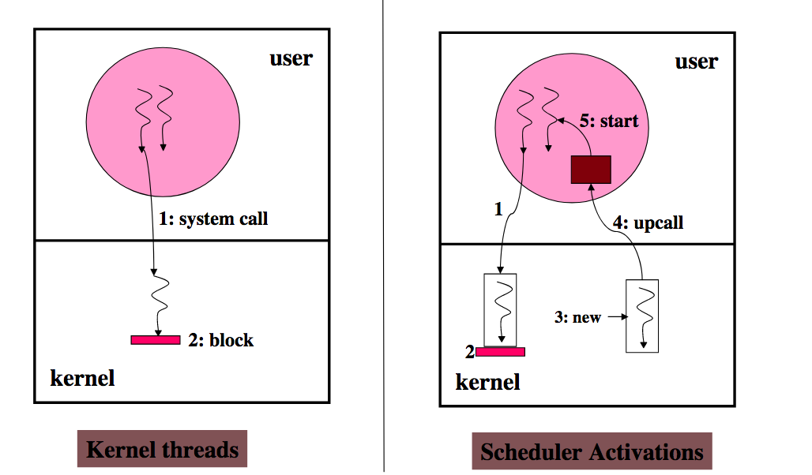
Lifecycle of SA

Slide 73
SA lifecycle
On program start:
New SA is created, assigned a processor and "upcalled" (fixed entry point)
User-level thread scheduler initializes and runs on this SA
Kernel uses SA to notify the user-level about important events: preemption, I/O, page faults

Slide 74
MCQ PREPARTION –REFER OTHER STUDY MATERIAL ALSO(DON’T RELY ON THIS ONLY)
https://edurev.in/course/quiz/attempt/-1_Test-Process-Synchronization-2/e32110e0-033e-4260-9120-bfdaae14e0ce
https://www.studocu.com/row/document/government-college-university-faisalabad/operating-system/process-synchronization-operating-system-questions-answers-sanfoundry/13166033
https://engineeringinterviewquestions.com/mcqs-on-process-synchronization-answers/
http://dextutor.com/mcqs-based-on-process-synchronization/
https://examradar.com/mcqs/operating-systems-mcqs/operating-system-process-synchronization-mcqs/
https://testbook.com/objective-questions/mcq-on-concurrency-and-synchronization--5eea6a1539140f30f369f34c

Slide 75
SEMAPHORE PRACTICE QUESTIONS
https://www.gatevidyalay.com/semaphore-in-os-practice-problems/
https://www.sanfoundry.com/operating-system-mcqs-semaphores-1/
https://testbook.com/objective-questions/mcq-on-counting-semaphores--5eea6a1539140f30f369f359
https://testbook.com/objective-questions/mcq-on-binary-semaphores--5eea6a1539140f30f369f358
https://www.javatpoint.com/os-problem-on-counting-semaphore
https://mycareerwise.com/content/binary-semaphore-and-net-gate-question/content/exam/gate/computer-science

